Slide 1
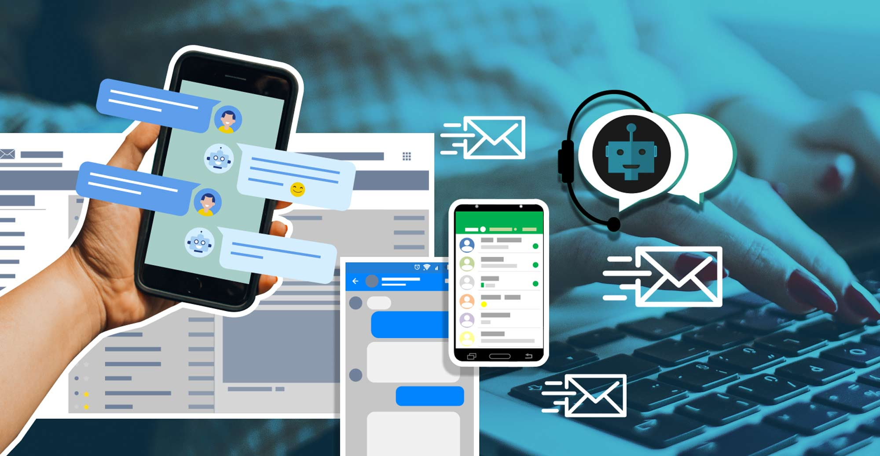
J.A.R.V.I.S
Isaura Cabrera
Tony Zhao

Slide 2
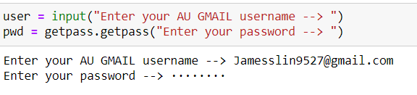

Dummy Email
In order to Protect James privacy rights, we thought that it would be best to create a “dummy email”. When creating this email, we are enabling permission to applications that can sign in. This will allow us too appropriately test, train without having personal information at risk.

Slide 3

Classification
This is project is solely based on classification, also known filtering. The filtering will be done by creating a dictionary and checking their frequency.
Ex:
Specific Subject Lines: “IC Partnership”, Key words in the email text body and from specific senders.

Slide 4

Data Collection
Jarvis will be working with a partial amount of real data regarding the Innovation Center. This Includes The Application process of the Innovation Partnership and the specifications of the Innovation Internship Program.
The Remaining of the data will be created using specific libraries to assist.
Ex: Faker Generator (Can create fake data to help with databases)

Slide 5

Conclusion
Groups will be created when classifying. JARVIS will be classifying emails and adding them to those groups. JARVIS, will be built on supervised learning and hope to fulfill tasks given.

